Slide 1
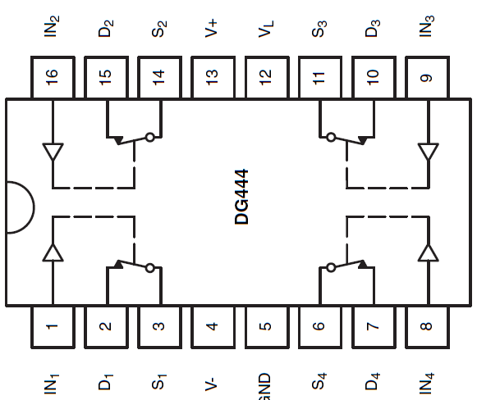
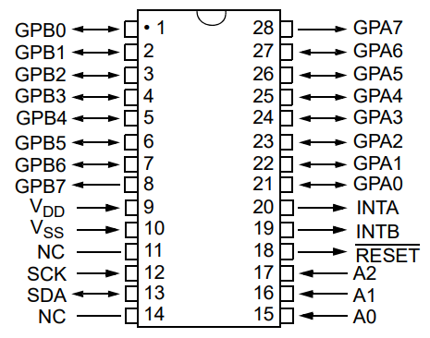
+5
GND
-5
SCK
SDA
RS
WE1
WE2

